Slide 1


Applied Data Science Capstone: Major Japanese Cities and Access to Healthcare
Kordell Mitchell Bernaldez Tan

Slide 2
Table of Contents
Introduction
Data Acquisition
K-Means Clustering
RESULTS
Conclusion

Slide 3
Introduction
Japan is currently seeing an expanding population as life expectancy rates increase [1]
As all citizens are required to have the state health insurance, the government of japan should analyze the distribution of healthcare facilities to organize these respective distributions; optimization of the amount and location of certain types of healthcare facilities would be a more efficient mode of investment in citizen healthcare [2]

Slide 4
Data Acquisition
We acquire the geographical locations of the prefectures of japan from simplemaps
Data includes the population of each city and the administration governing each city
IN THE SECOND PHASE OF THIS PROJECT, WE WILL SEE AN OBSERVATION OF INPATIENT AND OUTPATIENT VALUES THAT WILL HELP DESCRIBE THE RATE AT WHICH THE HEALTH CARE FACILITIES CAN PROCESS PATIENTS WITHIN EACH CITY
DATA IS ACQUIRED FROM E-STAT

Slide 5
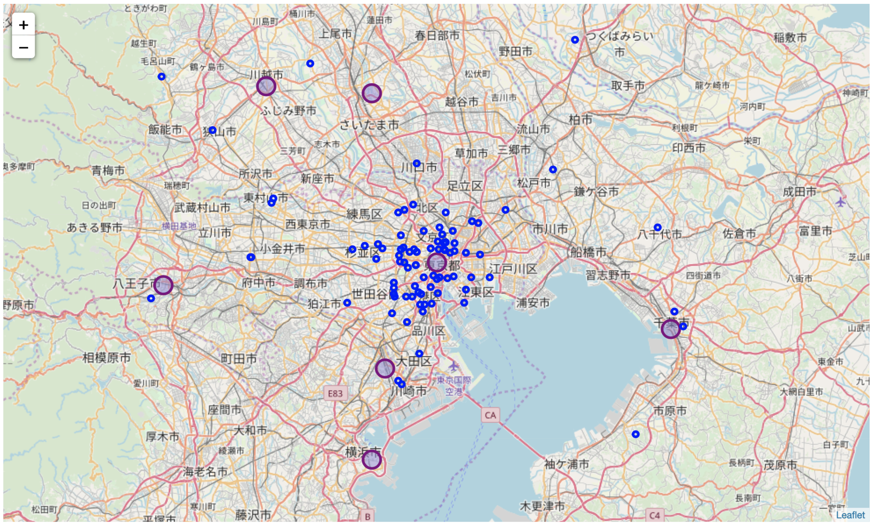
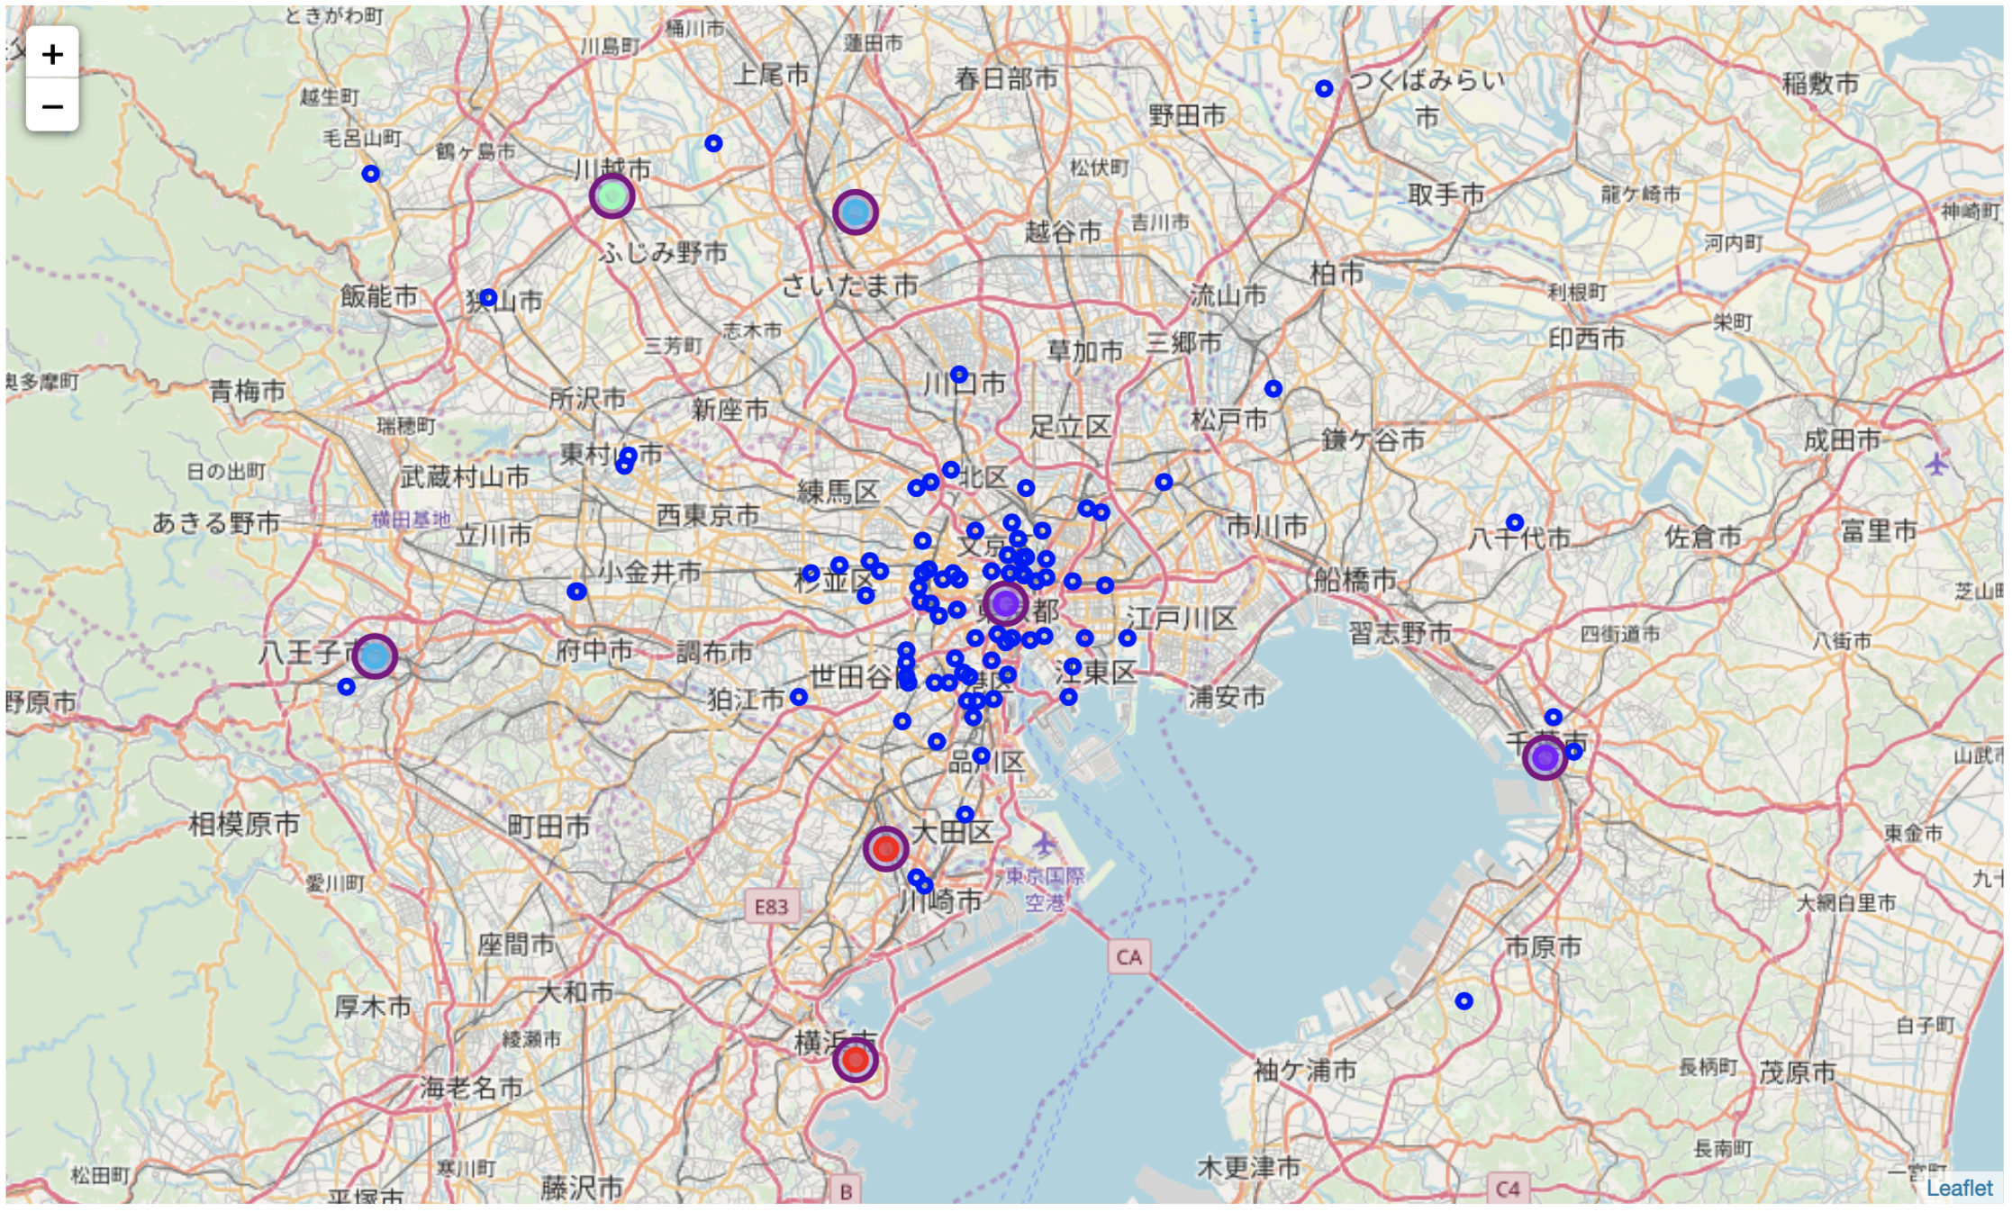
K-MEANS CLUSTERING
MAP OF JAPAN
MAP OF JAPAN WITH CLUSTERS

Slide 6
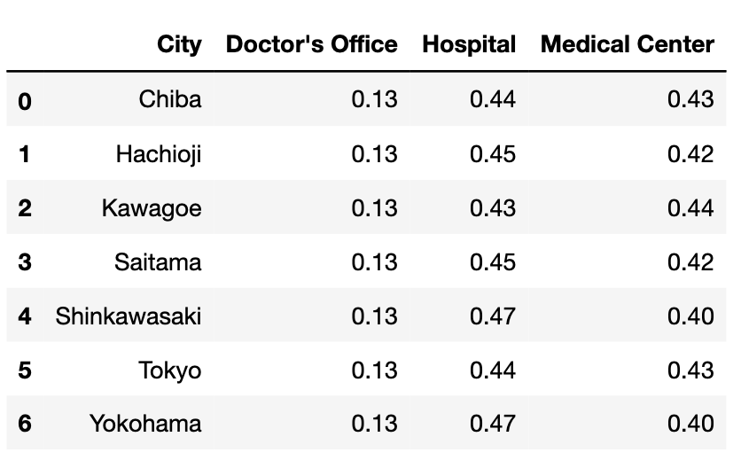
K-MEANS CLUSTERING (CON’T)
THE CLUSTER GROUPS ARE ORGANIZED BY THE RELATIVE DISTRIBUTION OF THE THREE CATEGORIES OF MEDICAL FACILITIES DESCRIBED BY THE FOURSQUARE API REQUEST

Slide 7
MAP OF CLUSTERS
BASED OFF THE UNIFORM DISTRIBUTION TABLE ABOVE, WE OBSERVE THE CITIES THAT HAVE THE SAME DISTRIBUTION OF EACH TYPE OF MEDICAL CENTER IN EACH CITY. FOR EXAMPLE, THE TWO SOUTHERN CITIES, SHINKAWASAKI AND YOKOHAMA HAVE THE SAME DISTRIBUTION AND ARE THEREFORE CLUSTERED TOGETHER (RED).

Slide 8
RESULTS
Based on the cluster analysis, we can observe the types of medical facilities that are most abundant in the varying cities surrounding Tokyo
factors that contribute to the definition of these cluster groups include the first, second, and third degree of similar facility types distributed around these particular regions, the respective distribution frequencies of each type of facility, and the distance to each other

Slide 9
CONCLUSION
FURTHER EXPLORATION OF THE HEALTH DATA ACQUIRED FROM E-STAT WILL BE USED TO MEASURE THE EFFICIENCY OF THE DISTRIBUTIONS OF EACH TYPE OF FACILITY ACROSS EACH PREFECTURE
DEFINITION OF EACH TYPE OF FACILITY WOULD BE DISCUSSED

Slide 10
References
[1]H. Cortazzi, "Japan's population problem | The Japan Times", The Japan Times, 2019. [Online]. Available: https://www.japantimes.co.jp/opinion/2015/11/19/commentary/japan-commentary/japans-population-problem/#.XRbY5i2ZNQI. [Accessed: 29- Jun- 2019].
[2]"Healthcare in Japan", Internationalstudentinsurance.com, 2019. [Online]. Available: https://www.internationalstudentinsurance.com/japan-student-insurance/healthcare-in-japan.php. [Accessed: 29- Jun- 2019].

